Slide 1
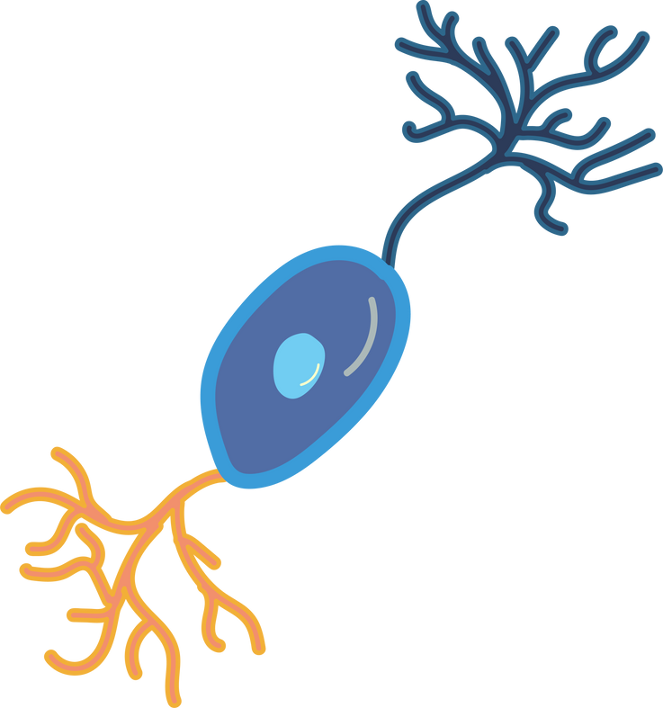
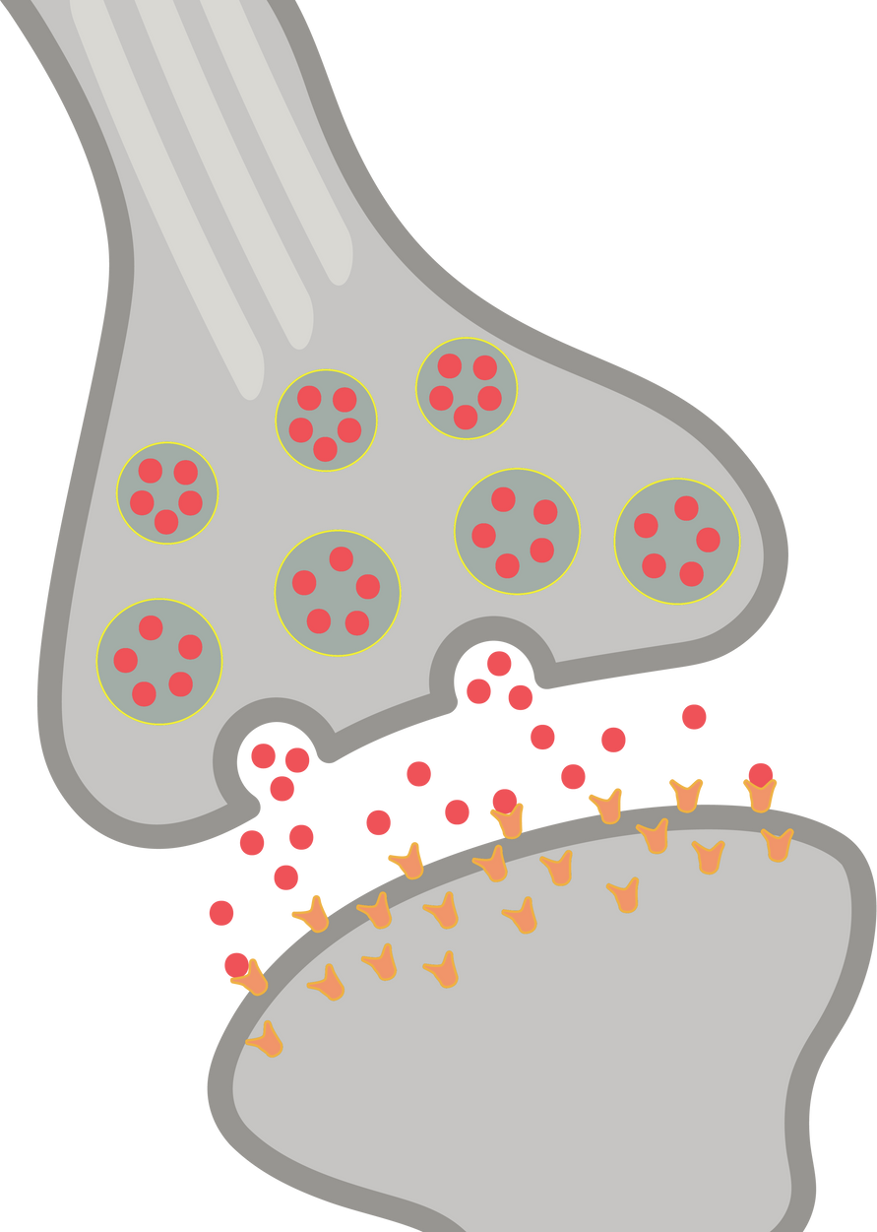
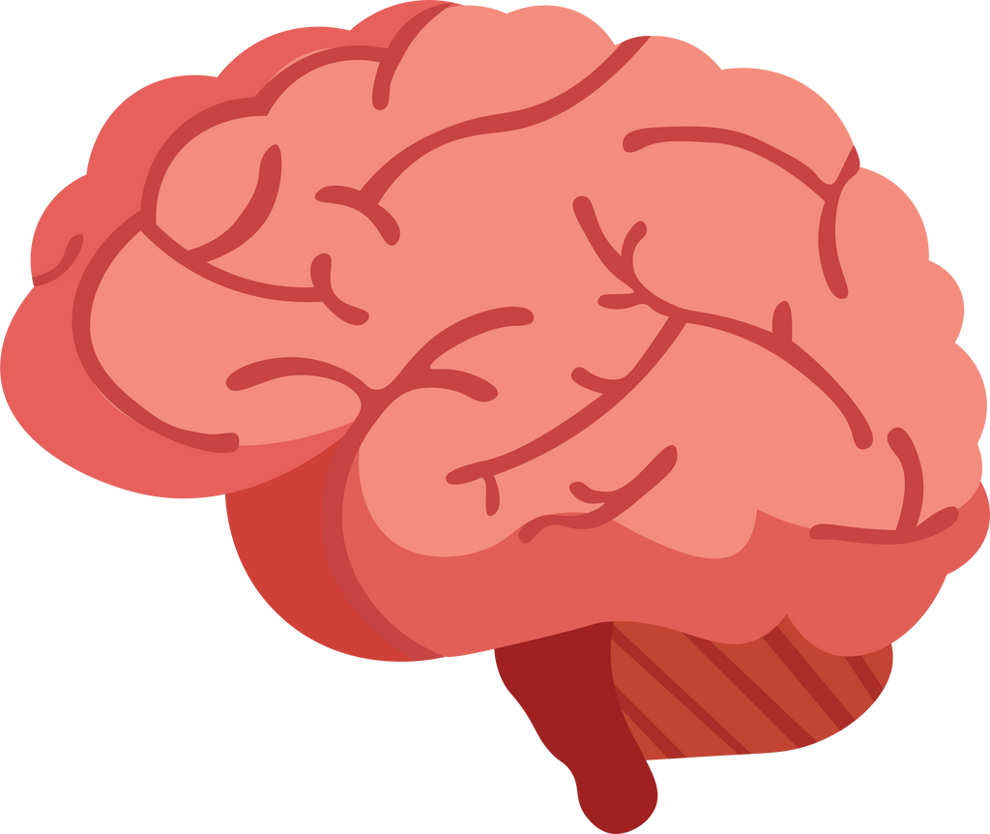
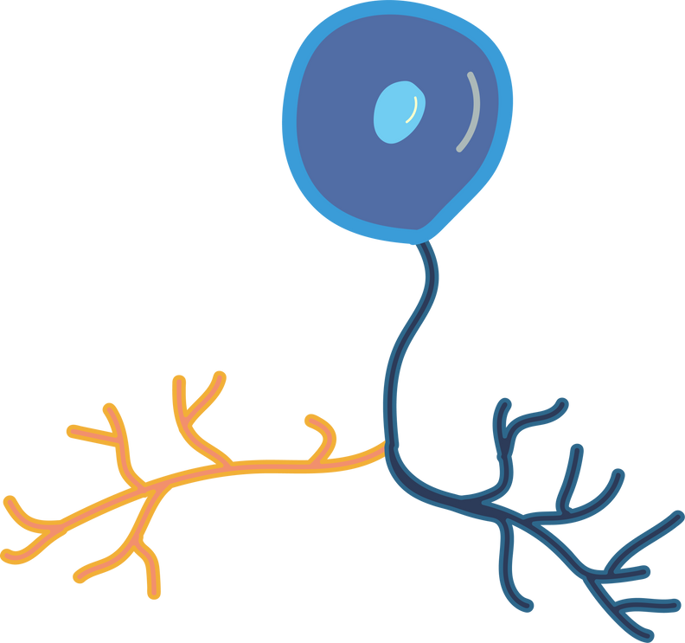
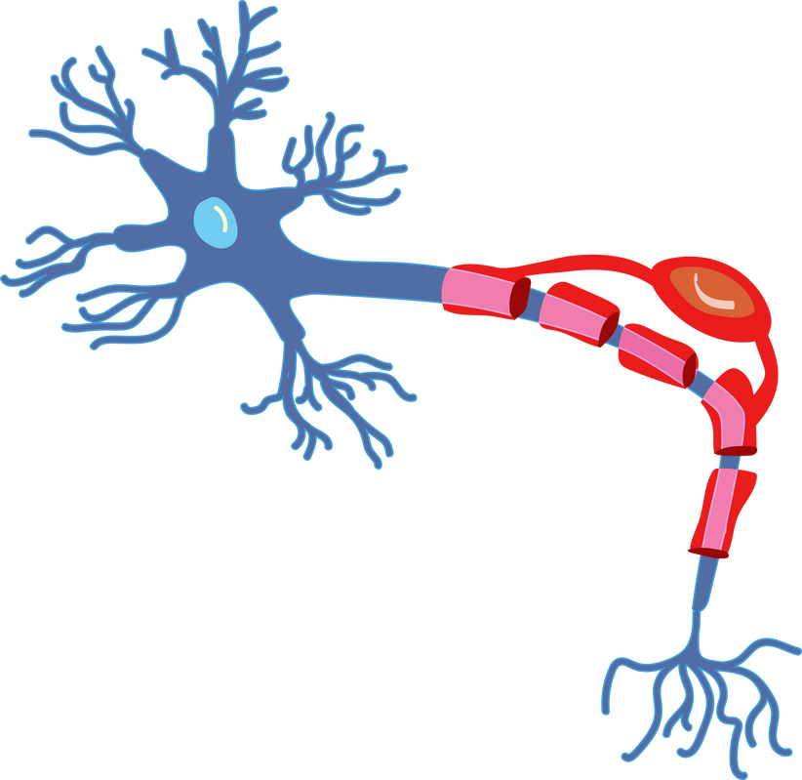
Sparse Transform and Compressed Sensing for MRI Image Reconstruction
Group 16:
P. Sathvik - 24240
Ch. Uday - 24210
G. Varshini - 24216
K. Sai Ganesh - 24226

Slide 2
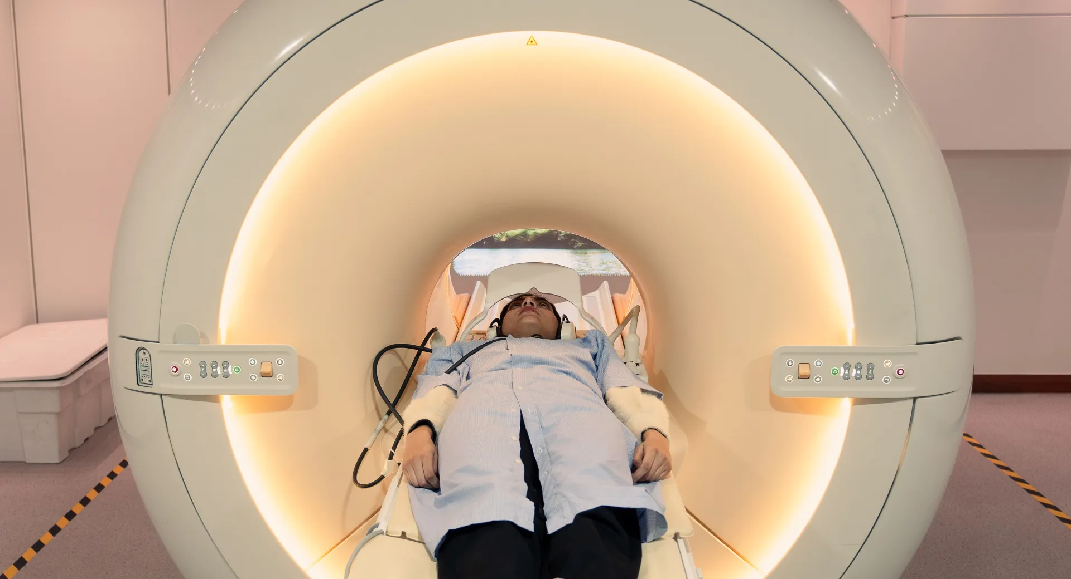
What is MRI?
MRI (Magnetic Resonance Imaging) is a medical imaging technique
Used to see brain, spine, organs, tissues
Produces high-quality images
Problem: MRI scan takes 30–40 minutes
Long scan time causes:
Patient discomfort
High hospital cost
Large data storage

Slide 3
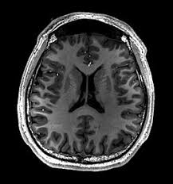
Problem Statement
MRI collects a huge amount of data
Full data collection = long scan time
If we reduce data → image quality decreases
Goal:
Get good-quality MRI images using less data and less time

Slide 4
What is Compressed Sensing (CS)?
Compressed Sensing is a smart signal processing technique that:
Uses fewer measurements
Still reconstructs the original image accurately
“We don’t need all data if the image is sparse.”

Slide 5
Key Principles of Compressed Sensing
Sparsity
Image has many unimportant values
Only few important coefficients matter
Incoherent Sampling
Randomly collect data (not line by line)
Avoids repeating similar information
Non-linear Reconstruction
Use optimization algorithms
Recover image from incomplete data

Slide 6
Why Compressed Sensing is Important for MRI
Reduces MRI scan time
Less patient discomfort
Faster diagnosis
Lower storage and computation cost
Maintains diagnostic image quality

Slide 7
OBJECTIVES
To simulate under sampled MRI reconstruction.
To implement sparse transform-based reconstruction
algorithms.
To compare reconstruction quality using different methods.
To analyze trade-offs between image quality and computational complexity.

Slide 8
METHODOLOGY
Input MRI image acquisition
Image preprocessing and normalization
Transformation to sparse domain
Random under-sampling of coefficients
Inverse reconstruction
Performance evaluation using image quality metrics

Slide 9
Reconstruction Methods Used
The paper compares 4 algorithms:
DWT - Discrete Wavelet Transform
FFT - Fast Fourier Transform
DCT - Discrete Cosine Transform
Basis Pursuit (BP) - True Compressed Sensing method

Slide 10
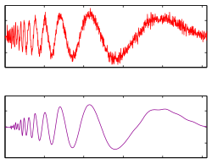
Algo 1:- DWT – Discrete Wavelet Transform
You take a big picture (MRI scan).
You break it into smaller building blocks (wavelet coefficients).
You keep only a random portion of those blocks (sampling).
You try to rebuild the picture from those fewer blocks.
Finally, you check how close the rebuilt picture is to the original.
Pros: Preserves edges
Cons:
Not consistent with real MRI physics
Image quality is low

Slide 11
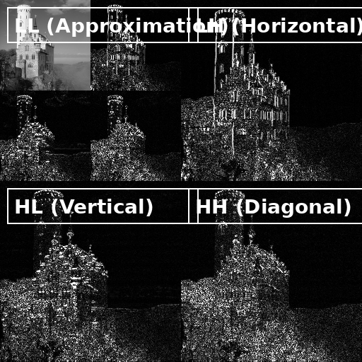
Algo 1:- DWT – Discrete Wavelet Transform
LL (Approximation) - Overall shape and smooth regions
LH (Horizontal Details) - Horizontal edges
HL (Vertical Details) - Vertical edges
HH (Diagonal Details) - Fine textures and noise
LL- Low pass filter applied to rows and columns
LH – Low pass filter to rows , high pass filter to columns
HL – High pass filter to rows , low pass filter to columns
HH - High pass filter applied to rows and columns

Slide 12
Algo 2:- FFT – Fast Fourier Transform
You take a big picture (MRI scan).
You convert it into frequency components.
You keep only a random portion of those frequency components (sampling).
You try to rebuild the picture using the inverse FFT from those fewer components.
Finally, you check how close the rebuilt picture is to the original.
Pros: Physically related to MRI
Cons: Visible noise and artifacts

Slide 13

Algo 2:- FFT – Fast Fourier Transform
Fast Fourier Transform (FFT) decomposes an image into its frequency components.
Instead of sub-bands like DWT, FFT represents the image using low and high frequencies.
Each frequency component indicates how rapidly pixel values change.
Low-Frequency Components (Center – low freq information)
Represent smooth regions and overall illumination
Contain most of the image energy
High-Frequency Components (Outer Regions – high freq information)
Represent edges, sharp transitions, and fine details
Capture textures and noise
Found away from the center of the spectrum

Slide 14
Algo 3:- DCT- Discrete Wavelet Transform
(DCT) represents an image as a sum of cosine functions of different frequencies.
It converts an image from the spatial domain to the frequency domain.
It separates the image into low-frequency (smooth areas) and high-frequency (edges and details) components..
Most important image information is concentrated in low-frequency coefficients (top-left region).
Small high-frequency coefficients are less important and can be removed to reduce data size.
The image is reconstructed by applying Inverse DCT (IDCT) using the selected coefficients

Slide 15
Algo 3:- DCT- Discrete Wavelet Transform
DCT-based processing in the project:
The input MRI/image is first converted to normalized grayscale format..
2D DCT (dct2) is applied to transform the image into frequency coefficients.
Coefficients are sorted by magnitude, and only a selected percentage (sampling rate) is retained.
Remaining coefficients are set to zero to simulate compression / sparse representation.
The image is reconstructed using Inverse DCT (idct2) and evaluated using PSNR, RMSE, and SSIM.

Slide 16
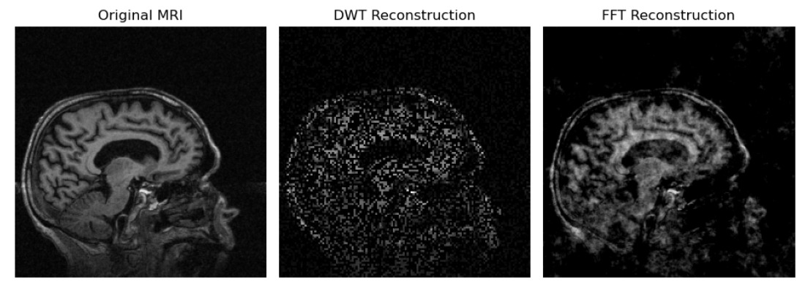
Results
Sampling rate 0.35

Slide 17
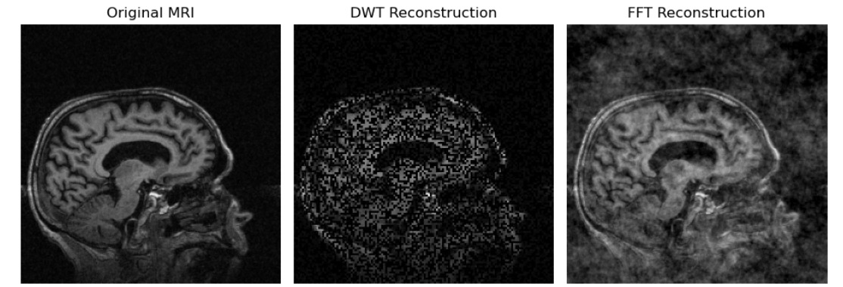
Results
Sampling rate 0.5

Slide 18
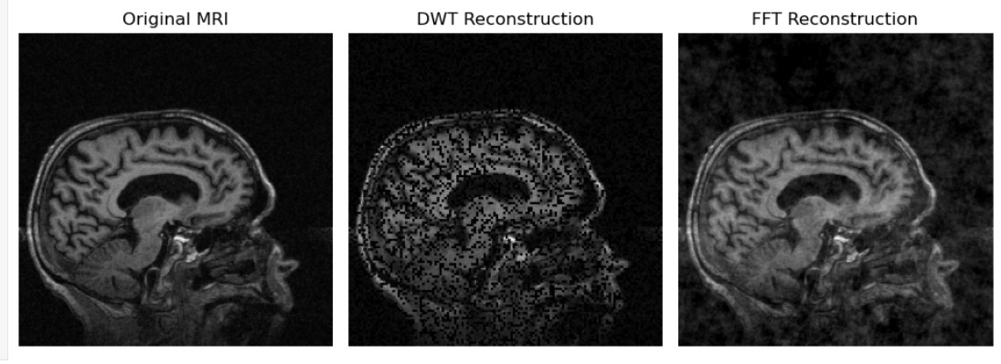
Results
Sampling rate 0.7

Slide 19
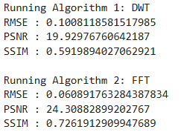
Results

Slide 20
Comparative Analysis: DWT vs FFT
Feature | DWT (Algorithm 1) | FFT (Algorithm 2)
Domain | Wavelet (time–frequency) domain | Frequency (k-space) domain
MRI Relevance | Not physically consistent with MRI | Physically consistent with MRI acquisition
Visual Quality | Grainy, patchy reconstruction | Clearer image with better structure
RMSE( Root Mean Square Error) | Higher (more error) | Lower (less error)
PSNR(Peak Signal to Noise Ratio): | Lower image quality | Higher image quality
SSIM(Structural Similarity Index) | Moderate structural similarity | Better structural similarity
Computation | Fast and simple | Fast and efficient
Overall Performance | Moderate | Better than DWT

Slide 21
Thank You

